Slide 1
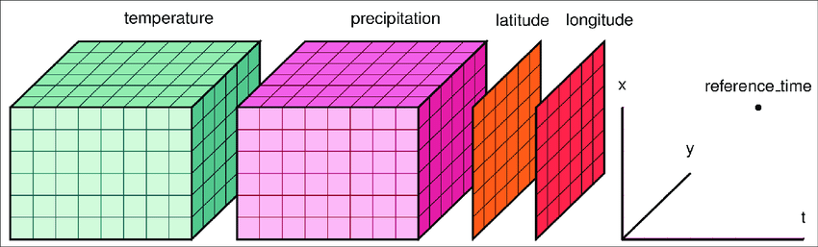
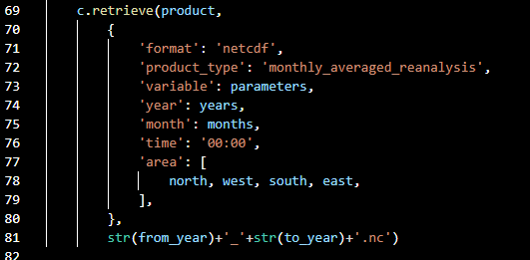
NCF file on server
Bathymetry
Wind speed
CONVERT
Script
Longitude
Latitude
Time
Wind speed
…
Bathymetry
Human activities
Fauna
Presence of infraestructure

